Slide 1
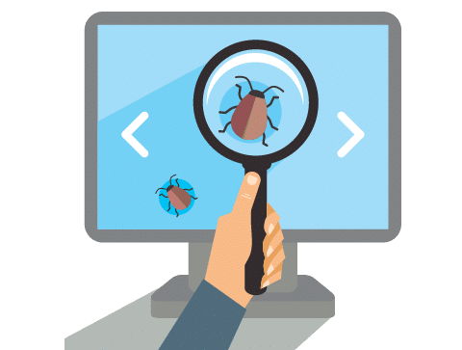
Software Testing Life Cycle
Presented by Priyan Indika

Slide 2
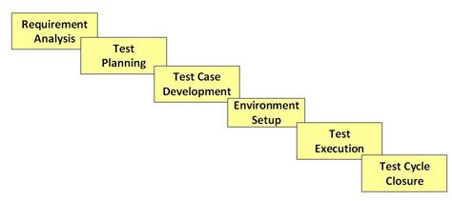
What is software testing life cycle ?
States as a sequence of activities, conducted to perform software testing.
It carried out methodologically to help certify your software product.

Slide 3
What is Entry and Exit Criteria?
Entry Criteria :
Entry Criteria gives the prerequisite items that must be completed before begin to testing.
Exit Criteria :
Exit Criteria defines the items that must be completed before testing can be concluded

Slide 4
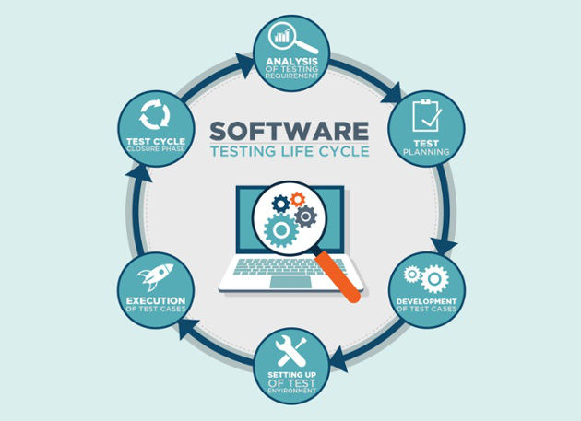
Software Testing Life Cycle Phases
Requirement Analysis
Test Planning
Test case development
Test Environment setup
Test Execution
Test Cycle closure

Slide 5
Requirement Analysis
The test team studies the requirements , which is testing point of view
QA team may interact with various stakeholders (Client, Business Analyst, Technical Leads, System Architects etc.)
Requirements could be either Functional or non Functional
Automation feasibility for the given testing project is also done in this stage.

Slide 6

Requirement Analysis
Activities
Identify types of tests to be performed.
Gather details about testing priorities and focus.
Prepare Requirement Tracebility Metrices.
Identify test environment details where testing is supposed to be carried out.
Automation feasibility analysis (if required).
Deliverables
RTM , Automation feasibility report. (if applicable)

Slide 7

Test Planning
Senior QA manager will determine effort and cost estimates for the project and prepare and finalize the Test Plan.
Test Plan and effort estimation documents are the deliverables
Activities
Preparation of test plan
Test tool selection
Test effort estimation
Resource planning and determining roles and responsibilities.
Training requirement

Slide 8
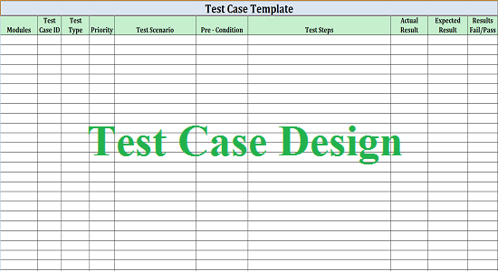
Test Case Development
Involves the creation, verification and rework of test cases & test scripts
Activities
Create test cases, automation scripts (if applicable)
Review and baseline test cases and scripts
Create test data (If Test Environment is available)
Deliverables
Test cases/scripts
Test data

Slide 9

Test Environment Setup
Test environment decides the software and hardware conditions under which is tested a work product.
Activities
Understand the required architecture, environment set-up and prepare hardware and software requirement list for the Test Environment.
Setup test Environment and test data
Perform smoke test on the build
Deliverables
Environment ready with test data set up ,Smoke Test Results.

Slide 10
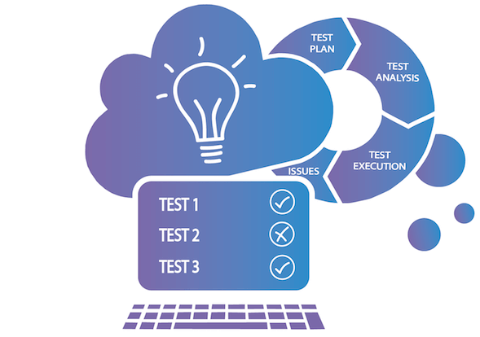
Test Execution
Bugs will be reported and back to the development team for correction and retesting will be performed. Completed RTM with the execution status , Test cases updated with results ,Defect reports are the deliverables.
Activities
Execute tests as per plan
Document test results, and log defects for failed cases
Map defects to test cases in RTM
Retest the defect fixes

Slide 11

Test Cycle Closure
Discuss and analyze testing artifacts to identify strategies that have to be implemented in the future. Test Closure report and Test metrics are the deliverables.
Activities
Evaluate cycle completion criteria based on Time, Test coverage, Cost, Software, Critical Business Objectives, Quality
Prepare test metrics based on the above parameters.
Document the learning out of the project
Prepare Test closure report
Qualitative and quantitative reporting of quality of the work product to the customer.
Test result analysis to find out the defect distribution by type and severity.

Slide 12
The End

